Slide 1
Possible velocity model of ions and fluid flow in the system
VE490 Kexin Li

Slide 2
Agenda
Model I
Working condition & Assumption & Modeling method.
Key function.
Simulation of the velocity function.
Discussion.
Model II (still learning)
Possible dimension of electrodes

Slide 3
Model I [1]
Working condition
Low voltage (< 1.4V tested in the experiment, 0.1V in simulation).
Low frequency (0.01kHz ~ 100kHz).
if too high, the polarization may be hard to happen, lose the non-linearity phenomenon.
Assumption
Electric field line is semicircular.
* Ignore the effect of multiple pairs of electrodes.
Capacitance can be described by an effective value of λ_{D} for a given applied amplitude.
All the ions in this separation of charge are mobile
The height of double layer is independent from the concentration of solution.
* The ions in the double layer move a negligible distance across the surface of the electrode during one cycle
* The thickness of the double layer was the same on both electrodes.
Modeling method
[1] Pumping of water with ac electric fields applied to asymmetric pairs of microelectrodes

Slide 4
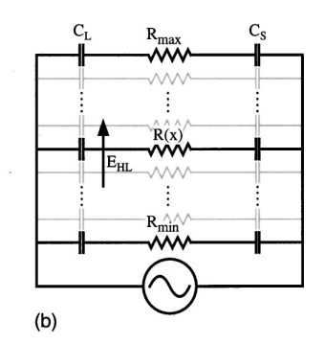
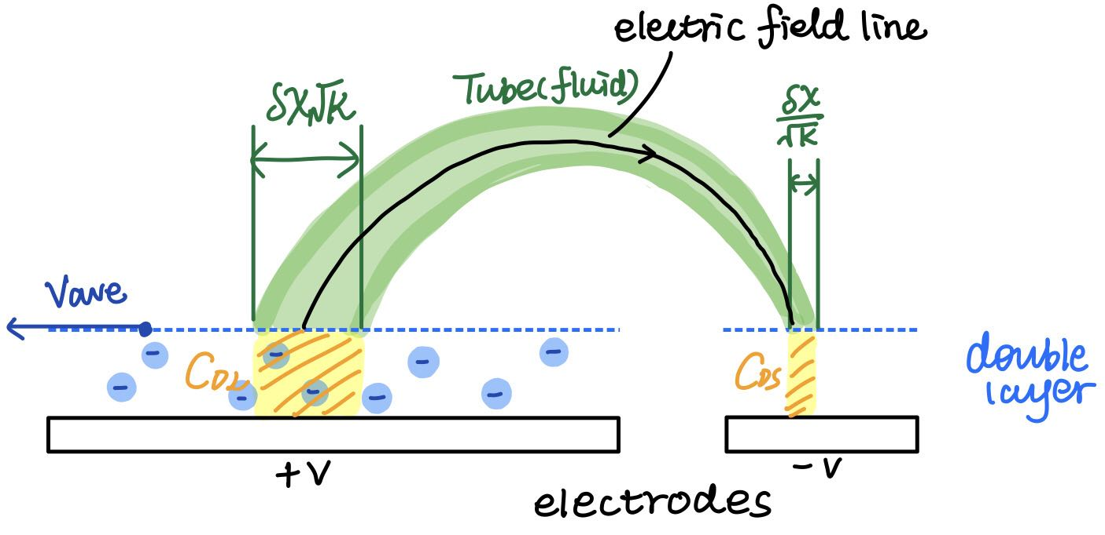
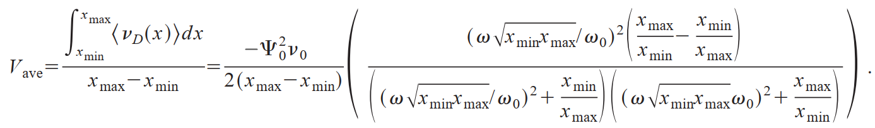
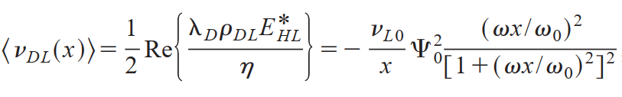
Model I [1]
Key equations
Eq.(1) （dependency with ψ₀²）
The average velocity of the fluid over the electrode surface
The time-average velocity of the fluid above the large electrode surface

Slide 5
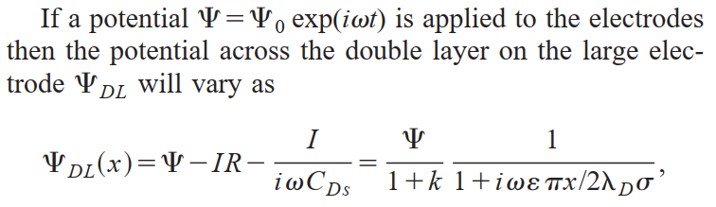
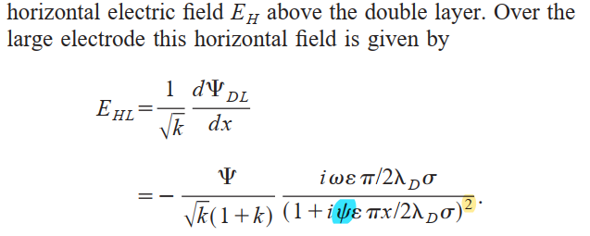
Key equations
Potential (why we need to know the potential?)
Electric field

Slide 6
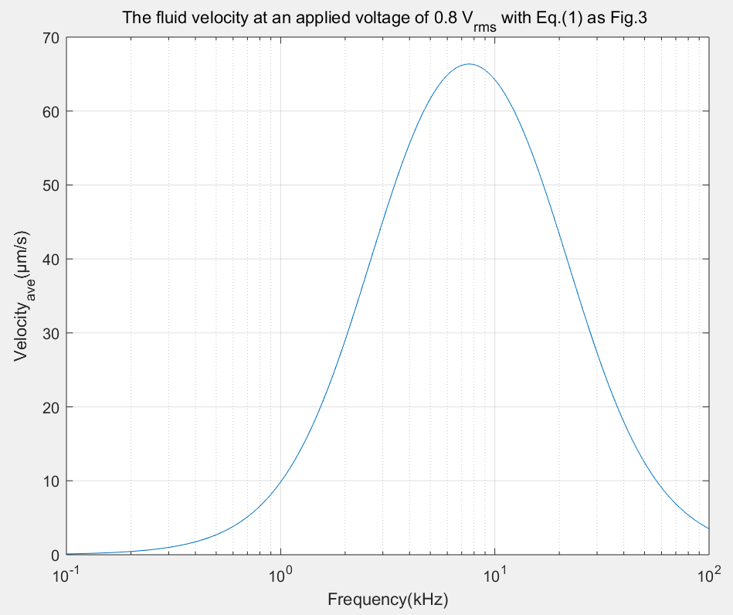
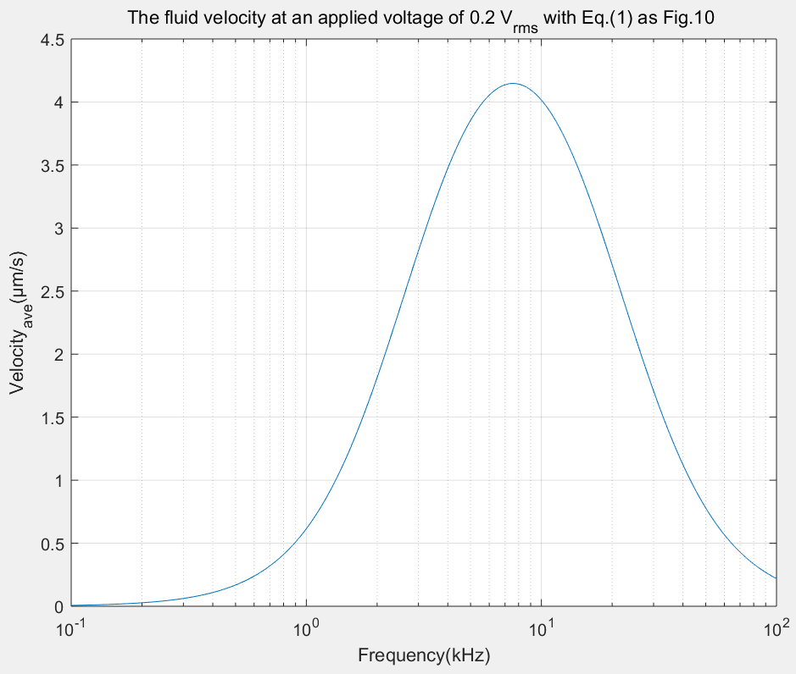
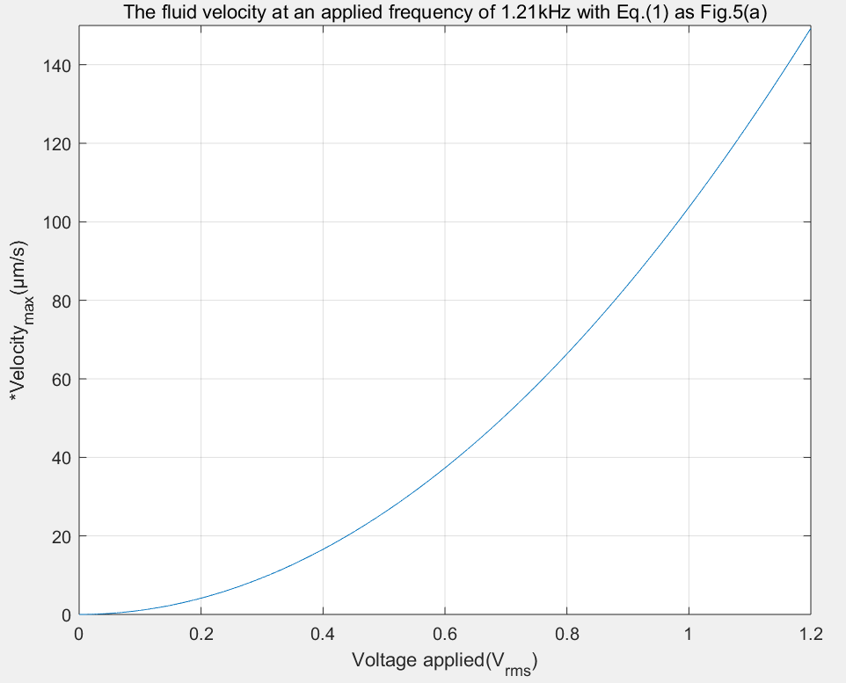
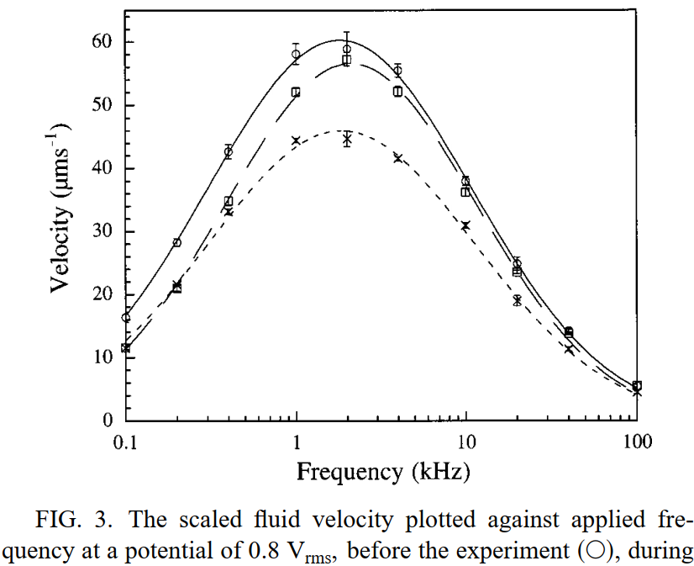
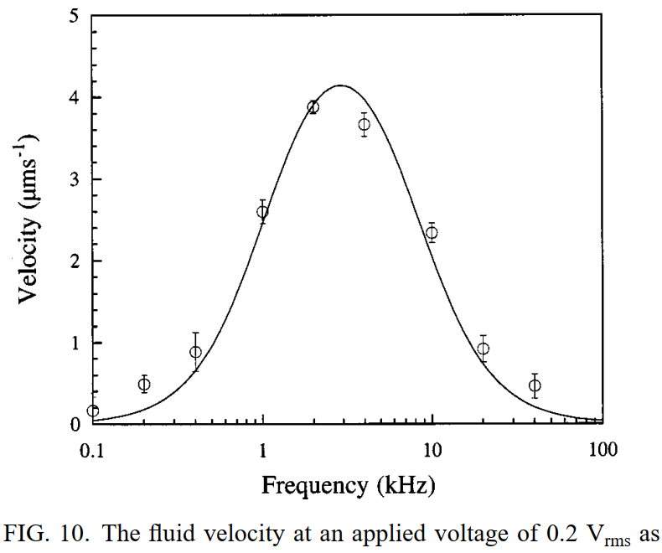
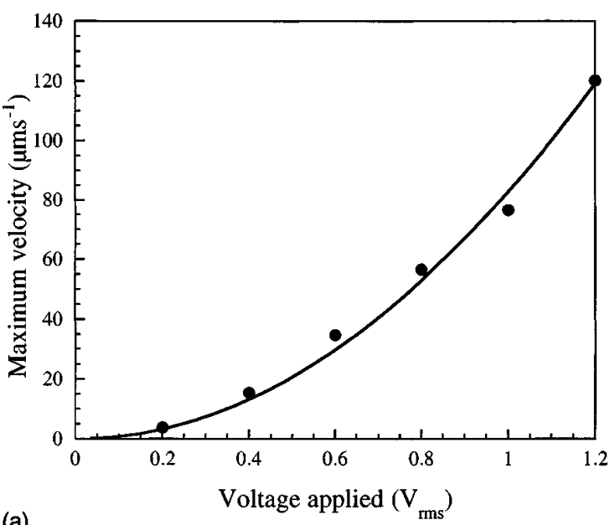
Simulation (All fitted with Eq.(1))
*Notice that the plot for the Maximum velocity Vs. Voltage applied is generated by the equation for average velocity
* The velocity only has one peak within the scale and is non-linear with respect to the frequency and applied voltage.

Slide 7
Model I [1]
Conclusion & Discussion
It builds the model for the ions and fluid flow at the surface of the electrode.
However, we still need more completed model to predict the bulk fluid flow and .
Key equivalence
Introduce the equivalent circuit of the system, especially the equivalence of capacitors and resistors.
Reasons
The model is for the condition when there’s only a pair of electrode.
Only consider the condition when applied voltage and frequency are low, so that the assumption of the capacitor within the double layer works.
The electric field line is considered as semicircle, the current flow in the bulk fluid has no model.
Ignore the special movement of ions within the double layer above the small electrode.
No hydrodynamic model for the bulk fluid flow arising from the flow on the surface of the electrode.

Slide 8
If we want to simulate…or build model
Key Problem
The distribution of the charge along the electrodes are not uniform, so that we need to find solution of equation that describe the electrical potential for the periodic.
According to Martin Z. Bazant[3], there’s no best model for the fluid flow under higher voltage(>5V or so.) & frequency (> 100kHz or so.).
Need to solve the system equation of
the electric field
microfluidic flow field
concentration field
-> Get the Pumping velocity U for an array of pairs of asymmetric electrodes (the velocity in the bulk electrolyte)

Slide 9
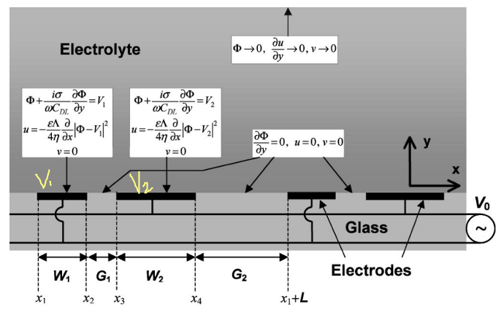
Model II [2]
To Solve :
Electrical equation
Velocity problem
Consider the boundary condition
-> the streamline function can be generated
[2] Pumping of Liquids with AC Voltages Applied to Asymmetric Pairs of Microelectrodes

Slide 10
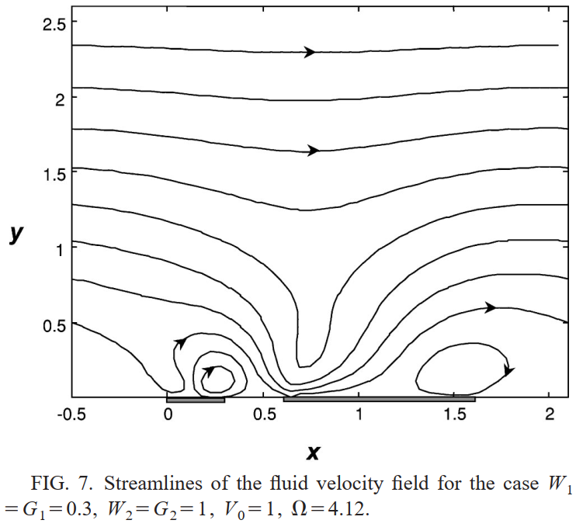
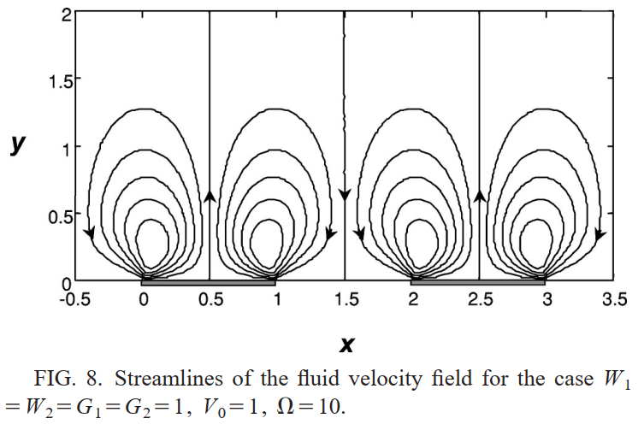
Goal of simulation
Reproduce the simulation result in [2]. Solving the equations to get the streamlines.
Difficulties
Lack of knowledge of electro-kinetics, electrochemistry, fluid mechanics.
Understand the electro-kinetics equations and solutions introduced in the paper.
Apply the unidimensional result or dependencies with actual values.

Slide 11
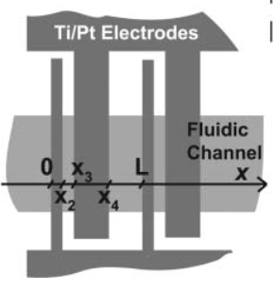
Possible electrodes dimension [4]
Contains 120 repeats of the asymmetric pair of electrodes
L = 50 μm, x2 = 4.2 μm, x3 = 8.7 μm , x4 = 34.4 μm.
The electrode array: 6 mm long and 320 mm wide thus allowing easy aligning of the 100 mm wide microfluidic channels.
[4] An integrated AC electrokinetic pump in a microfluidic loop for fast and tunable flow control

